Slide 1
Beer Analysis
YouTube Link: https://youtu.be/sFuMIslT-dc
Github Link: https://github.com/ellenlull/DS-6306-Beer-Analysis-Project
Bodie Franklin, Ellen Lull
Doing Data Science, DS6306, Section 401
March 7, 2020

Slide 2
Data Sets for Beer Analysis
Sample: 2410 beers with the following characteristics:
Bitterness(IBU)
Alcohol by Volume (ABV)
Style of Beer
Ounces
Sample: 559 breweries with the following characteristics:
Name of Brewery
Location (City, State)

Slide 3
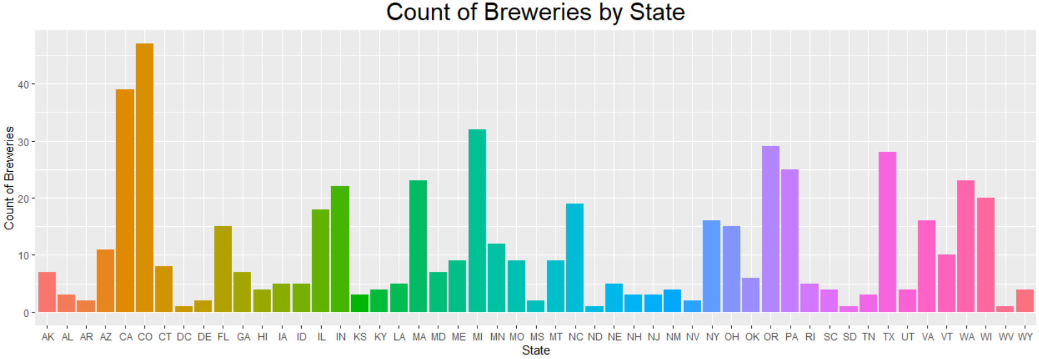
Breweries by State
Colorado(47)
California(39)
Michigan(32)
Oregon(29)

Slide 4

Missing Data
IBU Equation:
$$\frac{\text{Ounces}\text{ ∗ }\text{AA} \text{∗} \text{BT}}{7.25}$$
AA = Alpha Acid BT = Boiling Time
ABV Equation:
(OG-FG) * 131.25
OG = Original Gravity FG = Final Gravity
Beer data had 42% of the IBU values missing
Solving for IBU:
Grouped the beers by style to derive the product of AA*BT
Took an average of X
Applied the average of X to the respective style to derive IBU
Solving for missing ABV (62 of 2410 had missing ABV:
Performed similar average of ABV by Style.
Non Beer / uncommon styles:
Omitted non-standard beer styles: Cider, Shandy and Scottish Ale

Slide 5
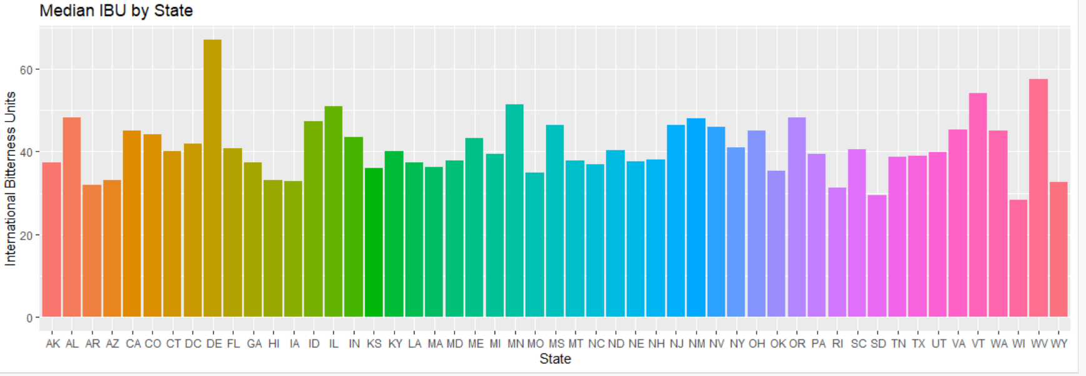
Median International Bitterness Units by State
Highest IBU in Breweries: Delaware, the highest at a median of 67 has only 2 breweries that each produce 1 beer type West Virginia (median of 57.5 ) has 1 brewery that makes 2 beer types

Slide 6
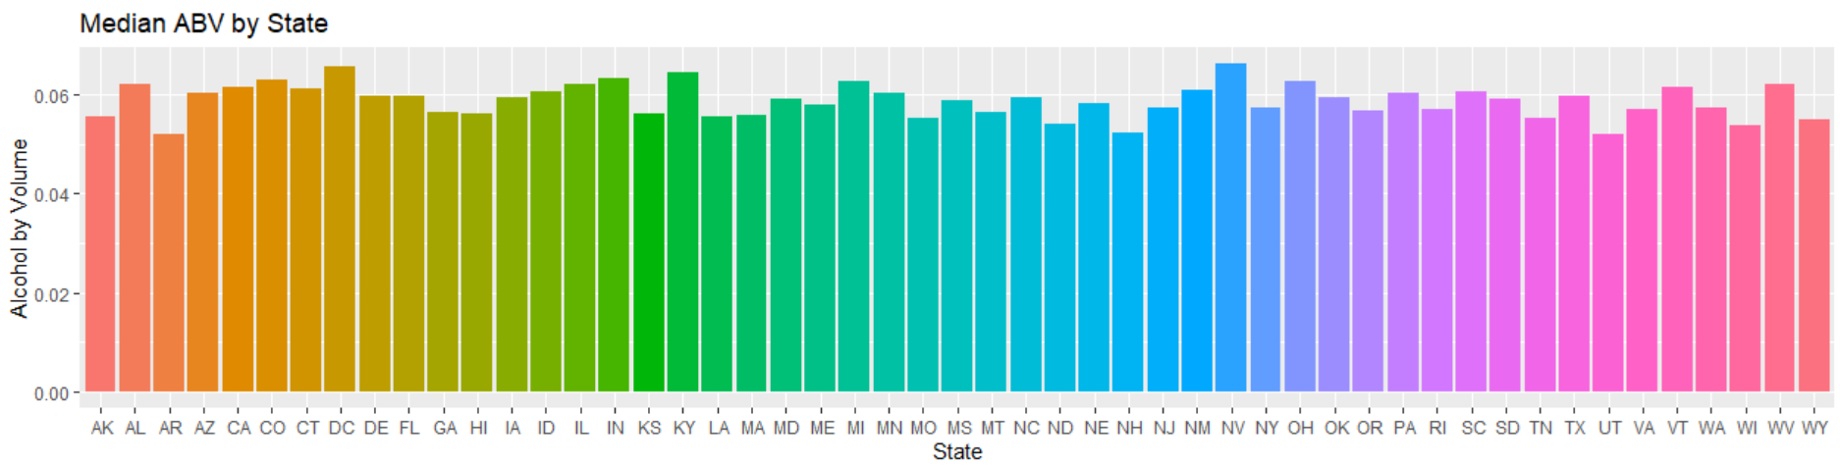
Median Alcohol by Volume
Breweries in NV (.0662) and DC (.0656) have the highest alcohol content DC has only one brewery, and NV has 2 breweries.

Slide 7
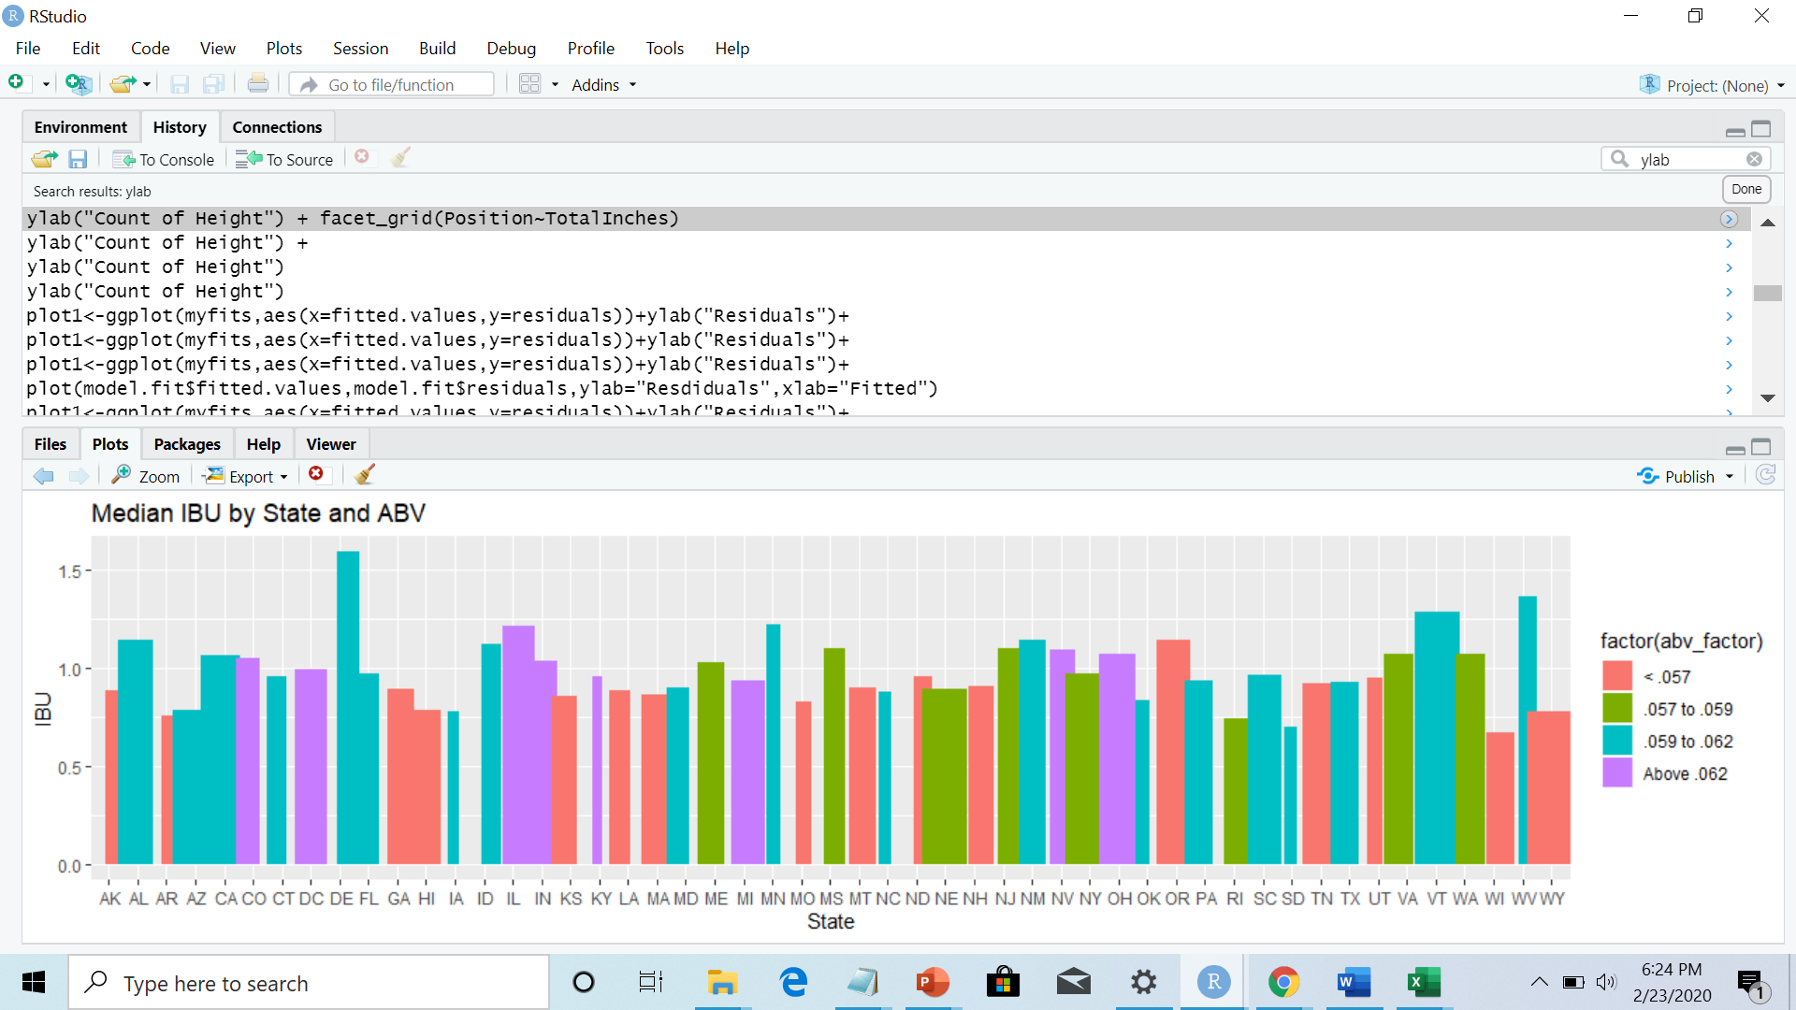
ABV and IBU by State

Slide 8
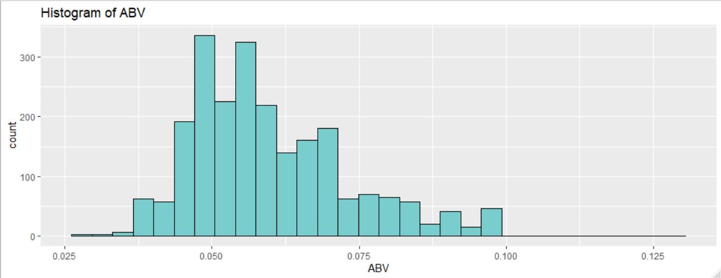
ABV: Summary Statistics and Distribution
Regardless of style, most beers have an Alcohol by Volume between 4.9% and 5.9%.
We believe that consumers are more likely concerned with bitterness (IBU) of beer rather than the Alcohol Content as evidenced by the distribution below.

Slide 9
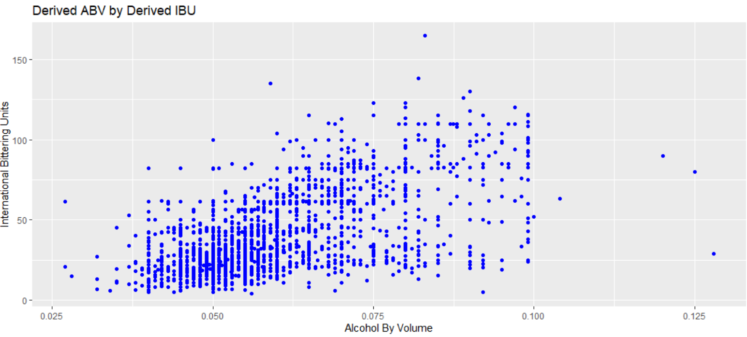
Relationship of IBU and ABV
The correlation is .6. As brew time increases, both ABT and IBU increase. Correlation is reduced due to variation of ingredients based on beer style.

Slide 10
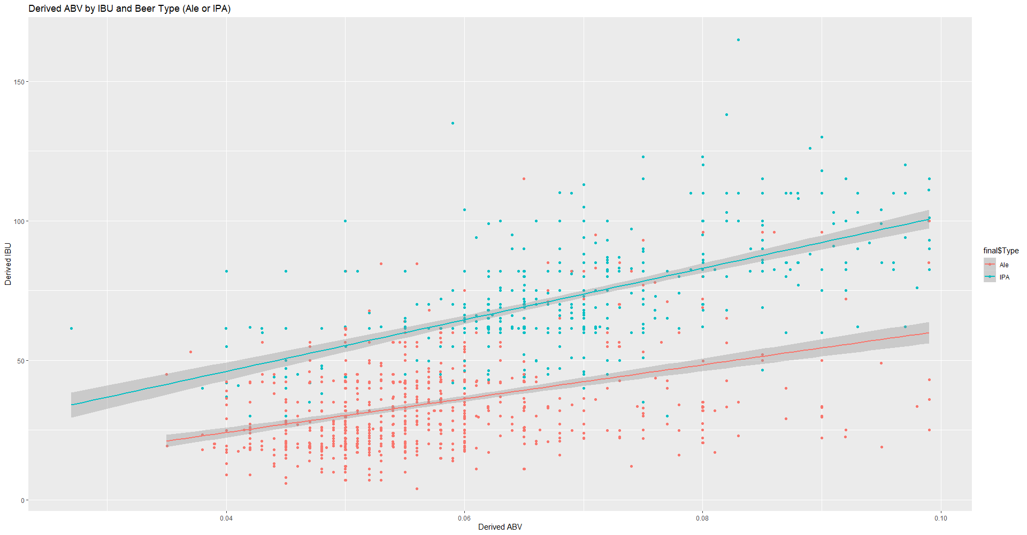
Relationship of IBU and ABV
The scatterplot indicates that IPA has a stronger linear relationship between ABV & IBU. The evidence gives us confidence that we can use KNN to classify a beer as IPA or Ale based on it’s ABV & IBU profile.

Slide 11
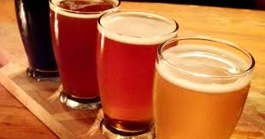
Profile of IPA & Ale
We determined that the type of beer can be predicted by the IBU and ABV Values
A T-Test was run to Perform T-test to determine if the ABV & IBU profiles were different. It showed the mean IBU value was significantly different from the mean ABV Value. This is shown in the prior graphs.
A regression model also shows that both the ABV and IBU values are significant and related when predicting the type of beer.

Slide 12
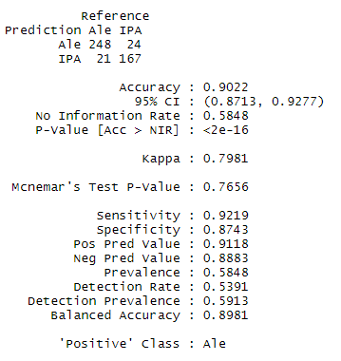
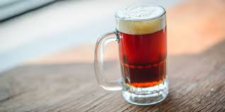
Classification of Beer
Through Back testing, we were able to successfully classify a beer as an IPA or Ale with 90% accuracy!
Based on this, we believe we could use this data set and model to classify a beer as an IPA or Ale utilizing it’s ABV & IBU profile.
.

Slide 13
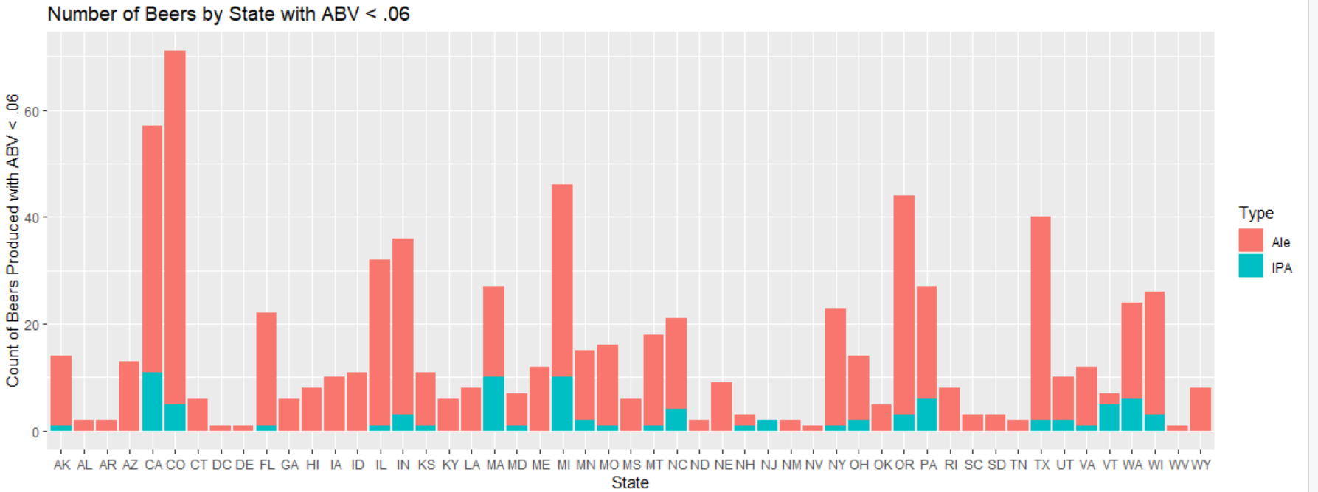
Count of Ales and IPAs Produced in each State where ABV < 6%
The following chart shows how many beers are produced by state where ABV is the most popular < .06

Slide 14
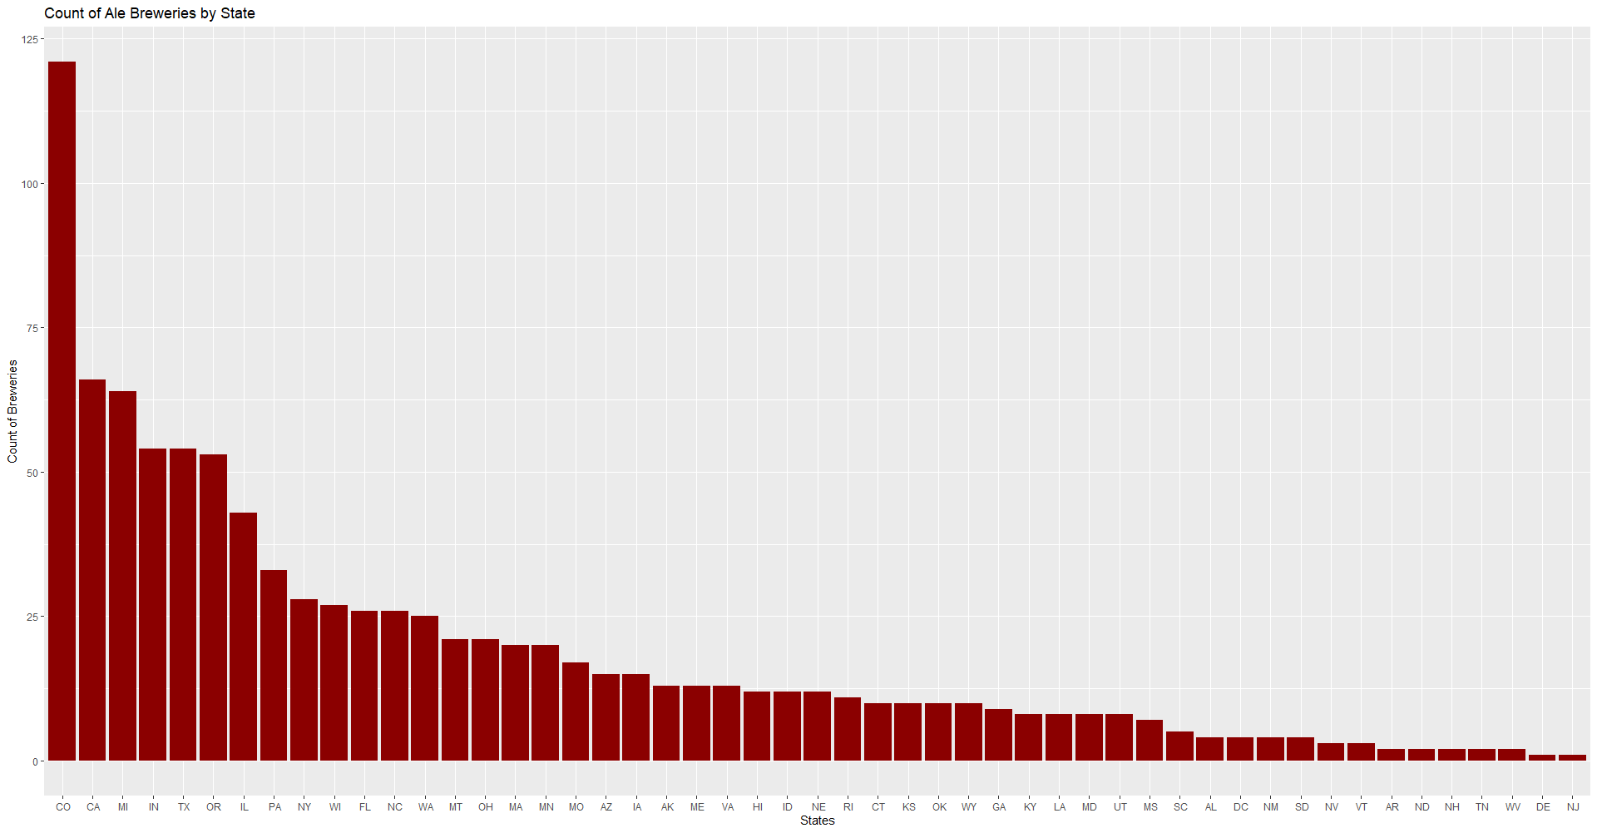
Additional Value
We believe that the area of entry would be to create an Ale beer. Ale appear to be more popular than IPA. This is perhaps due to the higher bitterness of IPA. States with between 12 and 26 Ale beers created are areas of opportunity to enter.
Type | IBU | ABV | count
Ale | 34.3 | 0.0568 | 962
IPA | 72.7 | 0.0688 | 571

Slide 15
Thank you
We hope this has given some valuable insights into craft beers, the craft beer market and the opportunities in this market.

